Slide 1
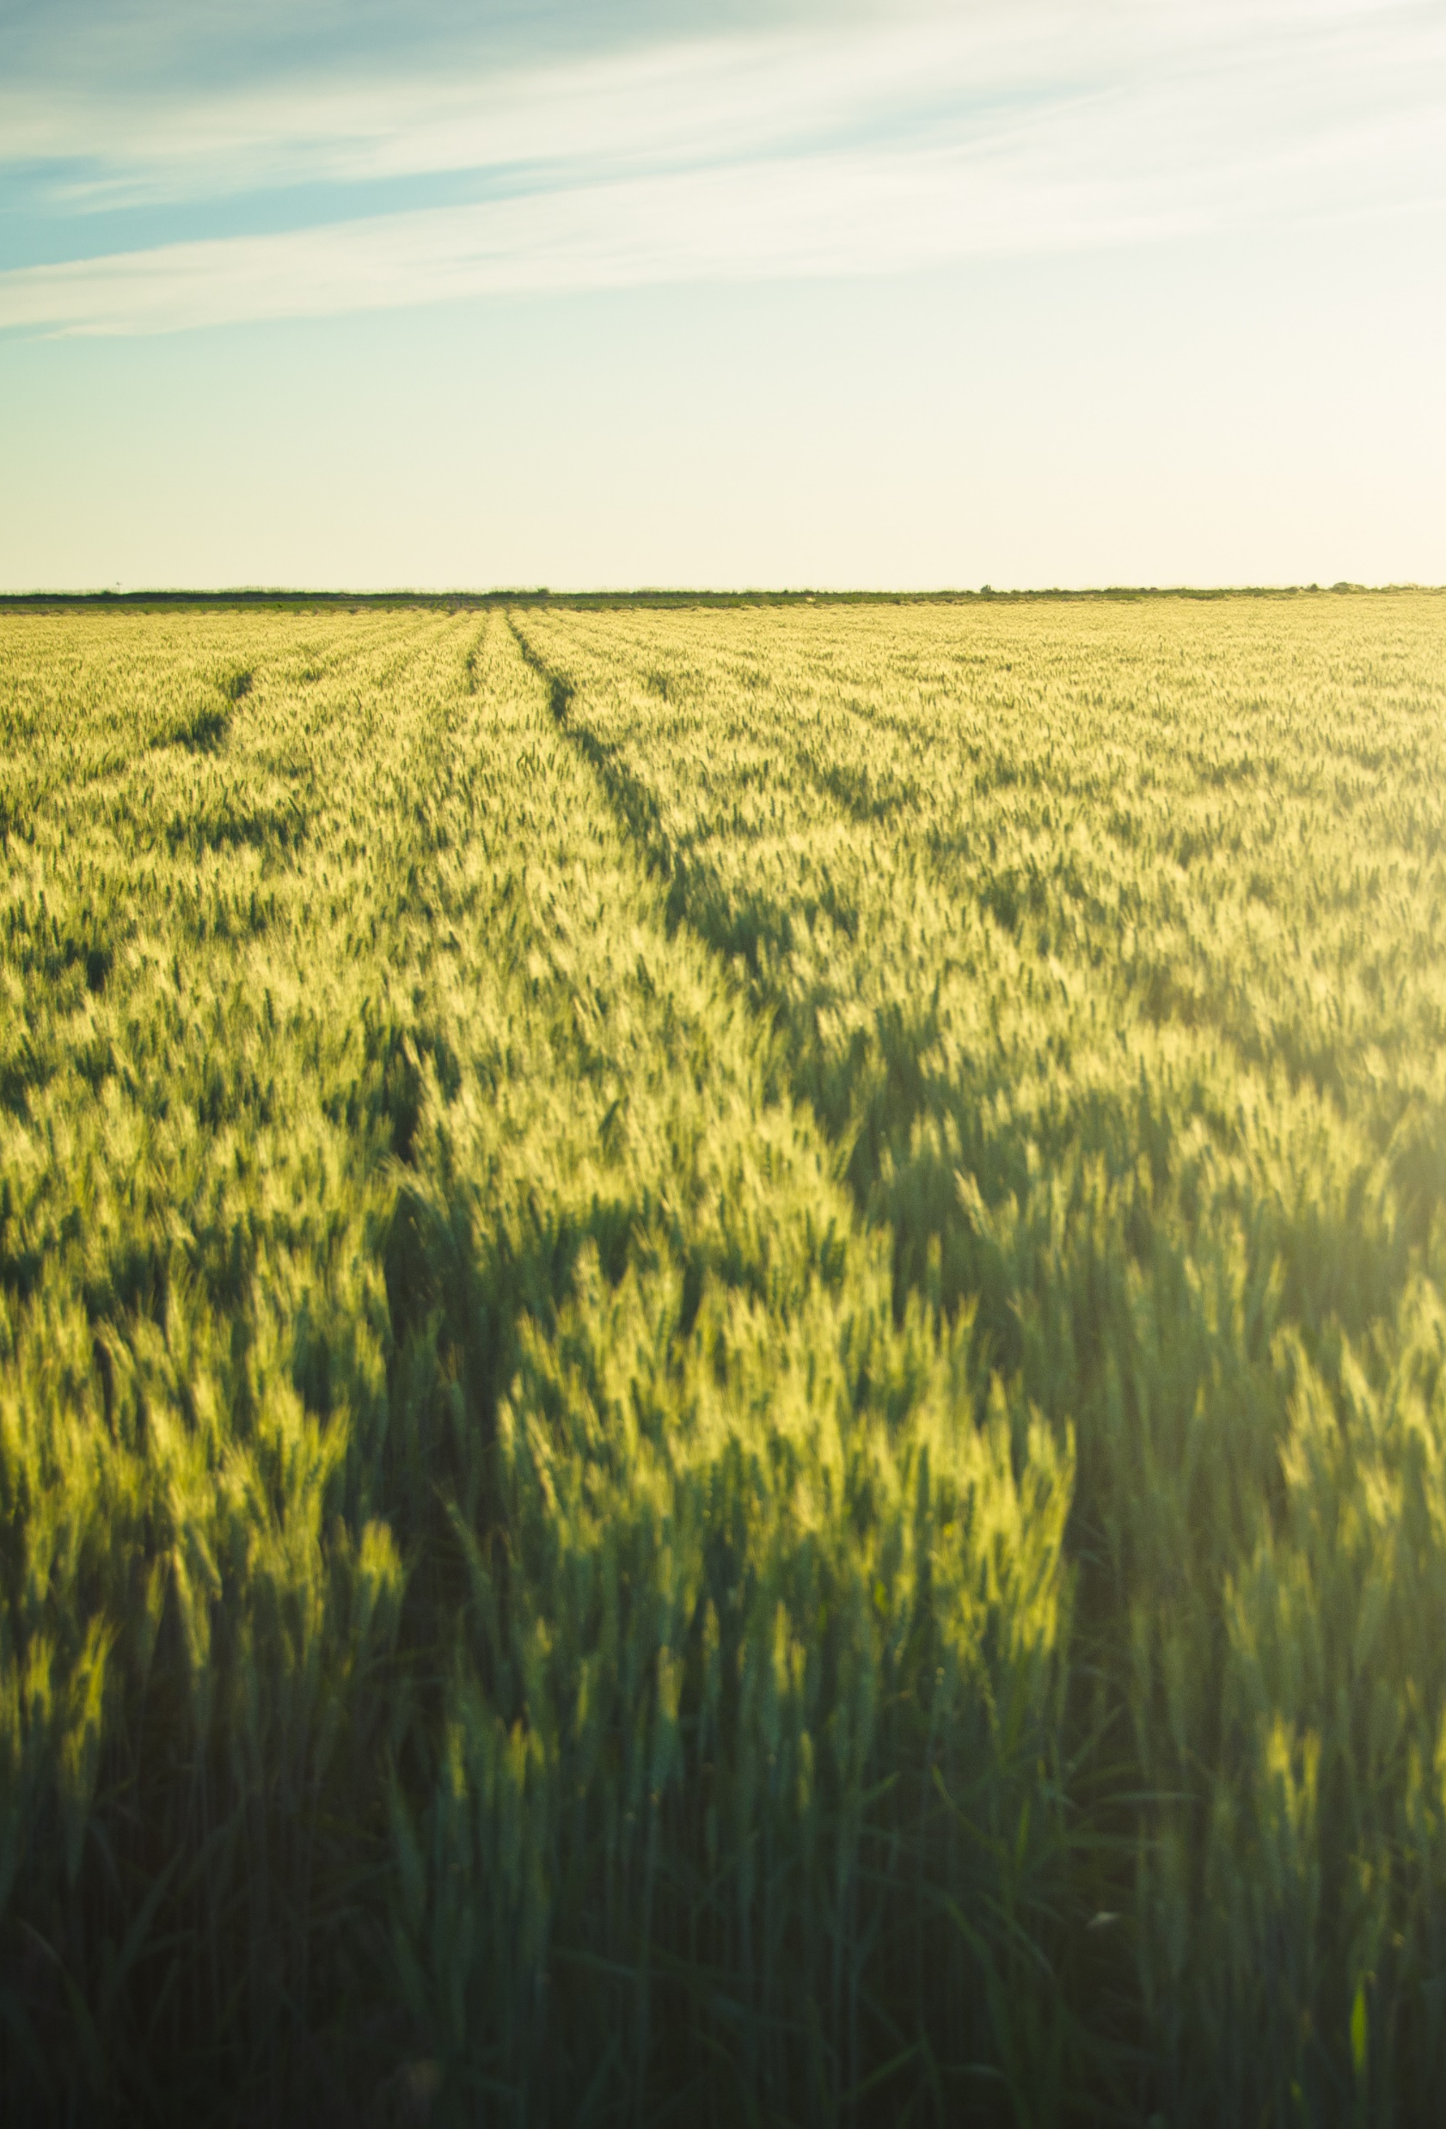
Crop Production Analysis

Slide 2
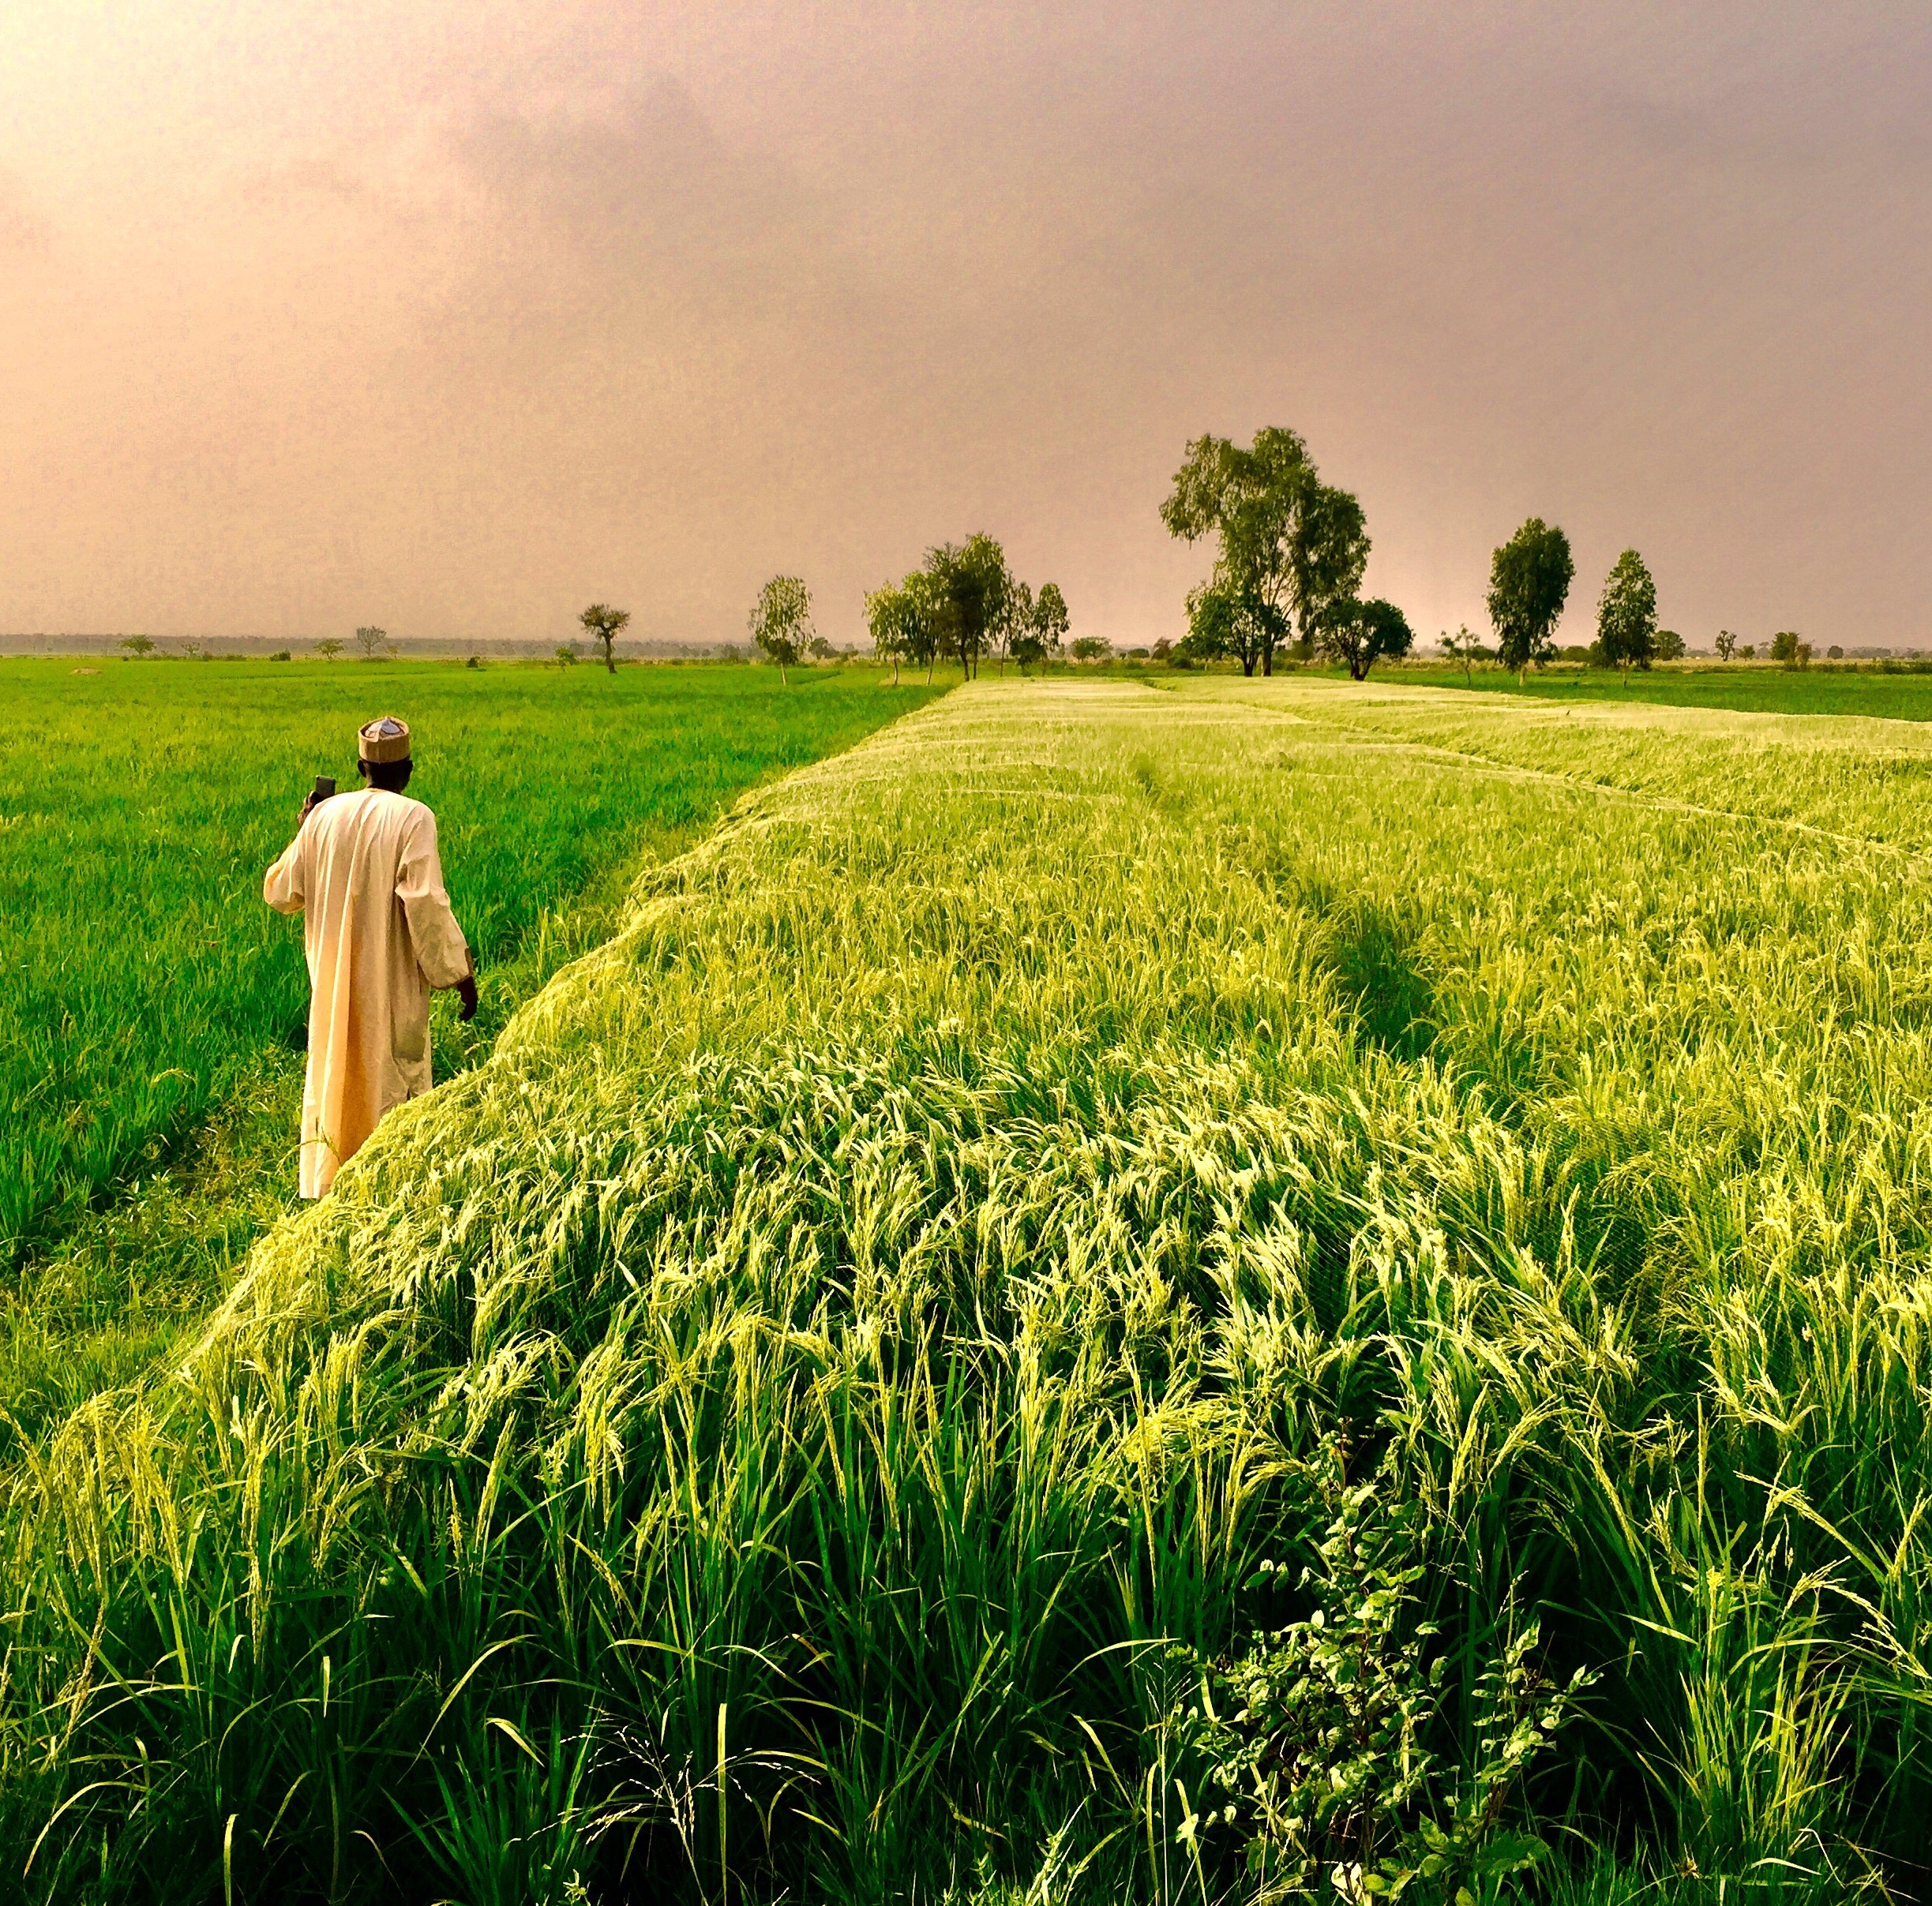
Today’s agenda
Introduction
Problem Statement
KPIs
Insights
Dashboard
Summary

Slide 3
Introduction
This report presents an analytical study of crop production patterns across various states and districts in India. Utilizing data from multiple crop years, the analysis covers essential aspects such as crop types, seasonal variations, and production yields. Through this exploration, the report aims to highlight key trends, regional disparities, and the efficiency of crop production across different areas. This data-driven approach seeks to provide insights that could support better resource allocation, season-specific crop planning, and overall improvements in agricultural productivity.

Slide 4
Problem statement
India’s agricultural sector faces challenges related to resource allocation, crop yield optimization, and seasonal variability, which impact food security and economic stability. Despite extensive agricultural activity across diverse regions, there is a need to identify optimal crop production practices and understand the impact of area under cultivation, regional conditions, and seasonality on crop yield.

Slide 5
KPIs
State_Name : Name of the State
District_Name : Name of the District
Crop_Year : Year in which crop grown
Season : Season in which crop grown
Crop : Crop Name
Area : Land Area in which crop was grown
Production : Number of production of crop

Slide 6
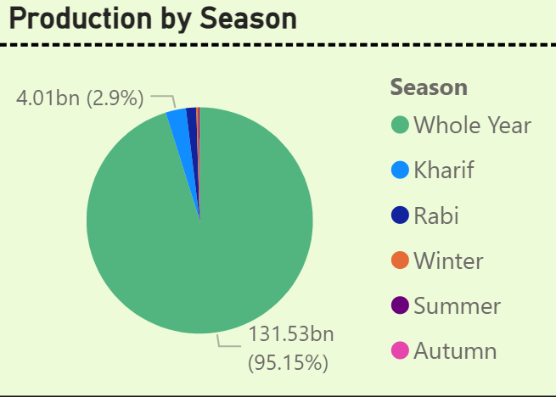
Insights-production by season
Whole Year is a season where we see the most production which saw a production of around 95.19% of total which is a large amount of production in that season.

Slide 7
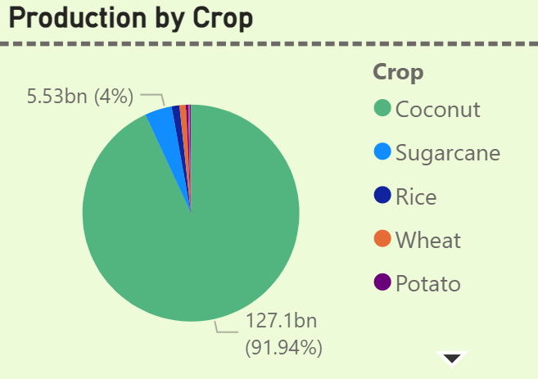
Insights-production by crop
Coconut is the crop which was produced at a larger rate covering 91.94% of total production of all crops.

Slide 8
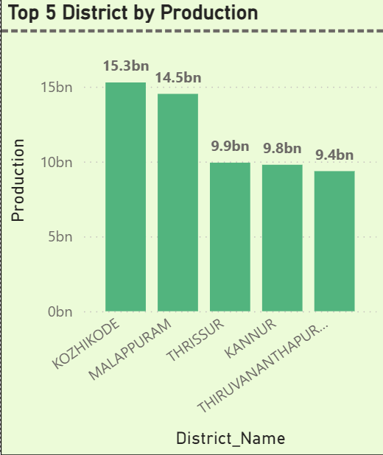
Insights-top 5 production district
These are the top 5 District by production as in the data.
They have produced the most crops across the given dataset in all those years and season.

Slide 9
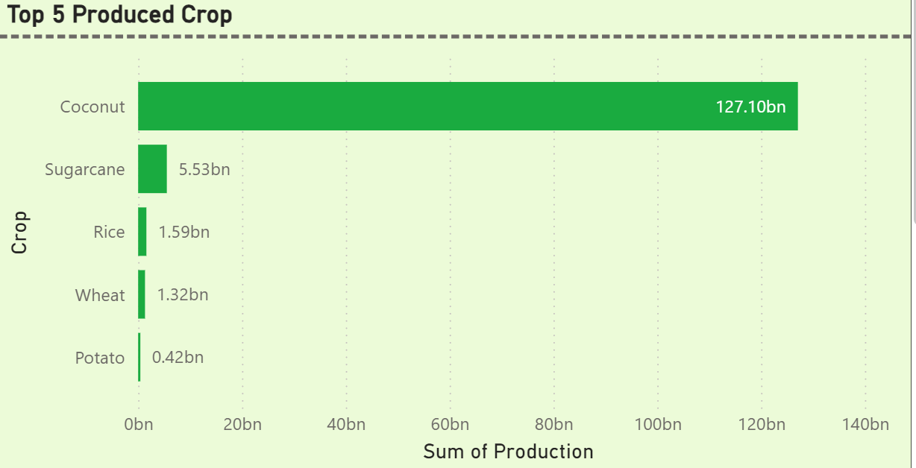
Insights-top 5 produced crop
These are the Top 5 produced crops across the India.
Coconut is the most produced crop with total production of 127.10bn

Slide 10
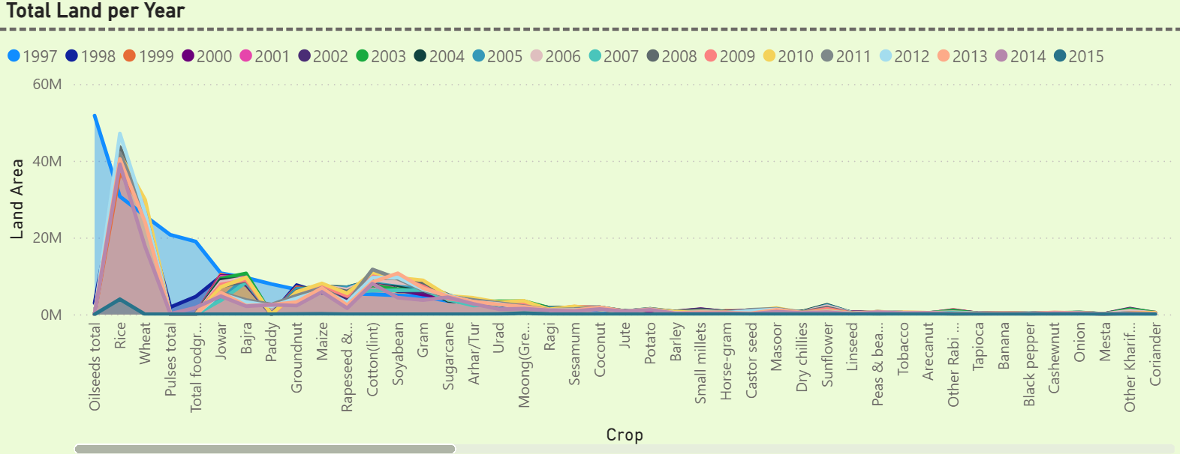
Insights-crop’s total land per year
These were the Total land area per year for every crop as shown below:

Slide 11
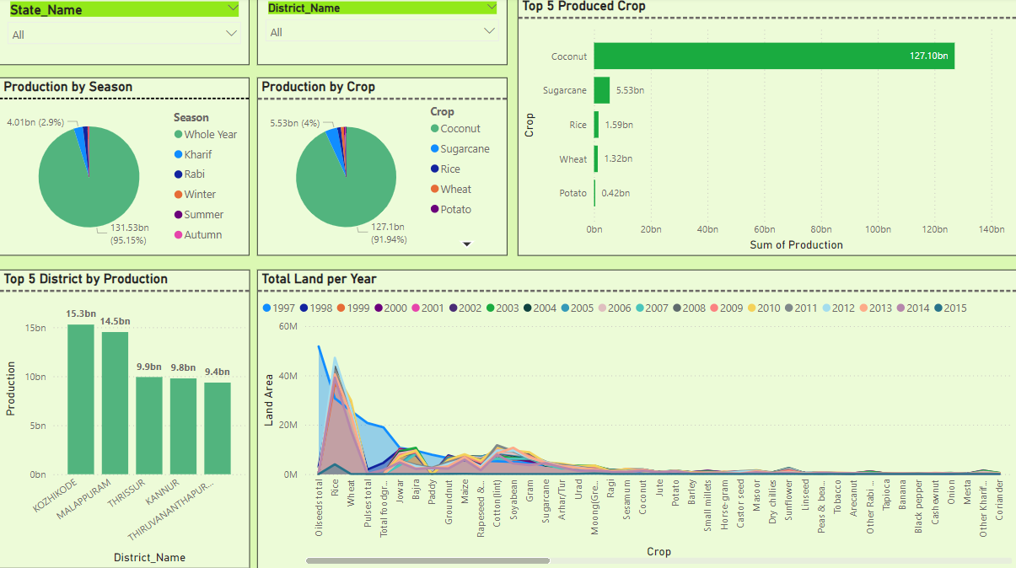
Dashboard-design

Slide 12
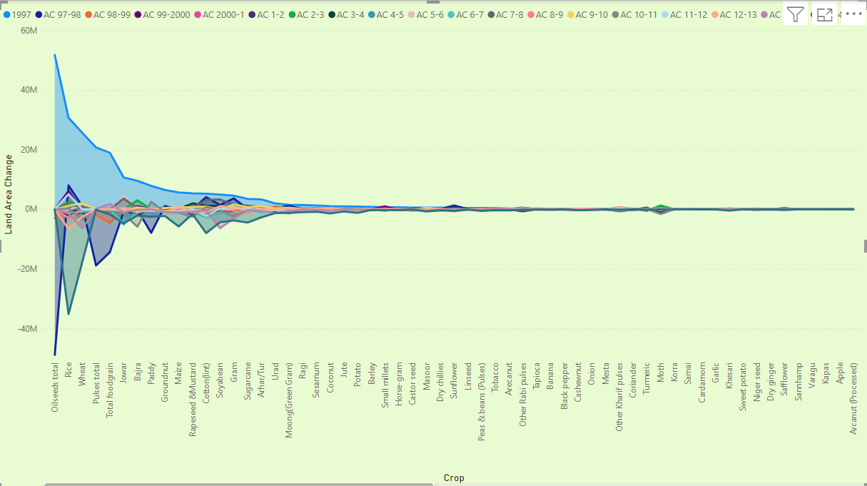
Dashboard-area change every year

Slide 13
summary
Whole year is the season having highest production with 95.15%.
Coconut is the crop that had highest production with 91.94%.
District that produced most crop is KOZHIKODE
Land area gradually decreased with time for mostly crops affecting their production numbers.

Slide 14
Thank you

